Slide 1
TEXT TO SQL
Sahil chakraborty
btech. Kiit-du Bhubaneshwar
Done under – Mr. KULDEEP Jolly
mr. himanshu pachori

Slide 2
The Problem
What is the problem?
Leveraging natural language processing techniques to facilitate intuitive querying of database information for users with varying technical skillsets.
Who has this problem?
Non-tech users
Why should this problem be solved?
Streamlining the process to ensure convenient and immediate access for all consumers.
How will I know this problem has been solved?
Achieving specific goals with targeted and effective approaches.

Slide 3
Background Information
What is your research?
  Evaluating strategies for enabling intuitive access to data through natural language interfaces for non-technical users.
  How did you discover this problem?
    We identified an issue through observing consumer difficulties in navigating toward desired information.

Slide 4
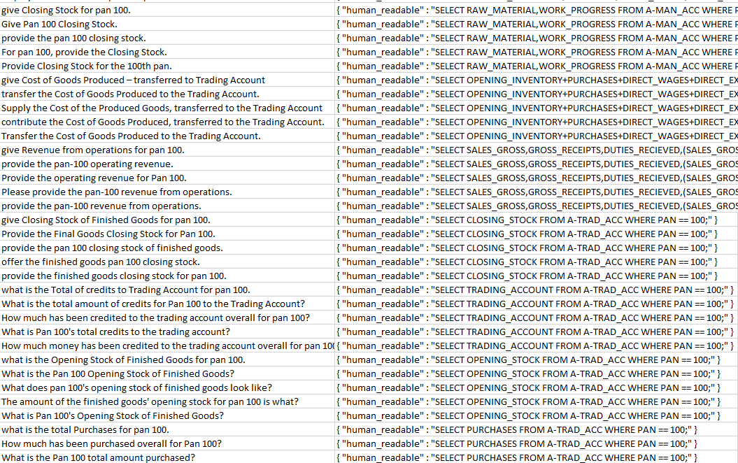
SAMPLE dataset

Slide 5
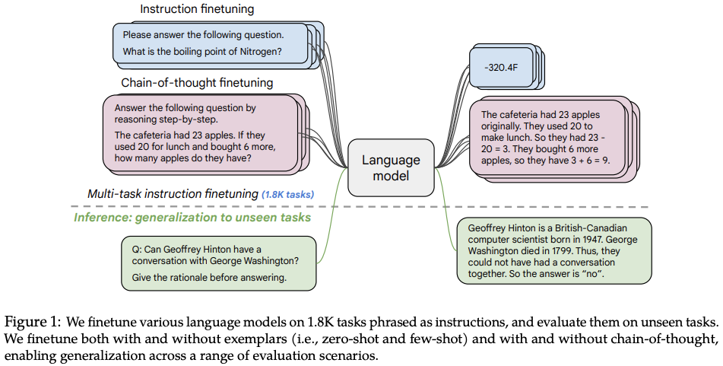
The Prototype
  For the best workable solution we will be using the Google-Flan-t5 with generated dataset to train our model and get the desired outputs
<Insert a picture or drawing of your prototype here>

Slide 6
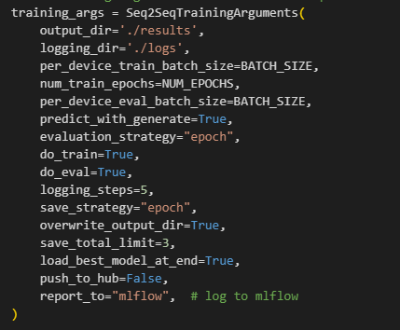
Testing The Prototype
  After testing we were able to get the desired outputs.
  With creating more dataset we will be able to achieve more accurate outputs.
  With many of the basic inputs we are able to get the achievable outputs

Slide 7
Redesigning The Prototype
  Use the data from your testing to redesign with…
    More tuning
    Different values of test variables
    Different sizes of training and validation sets
    Using other models.
  After all the enhancement we will be able to achieve more accurate results with the same training model.

Slide 8
OUTPUTS

Slide 9
Final Result
Once you have a final product, go back to your second slide and review the initial questions you answered
  Does your final prototype solve your problem for the person or people for whom it needs to be solved?
    If yes, WAY TO GO! But always think about if you can improve it even more!
    If no, copy this PowerPoint and start the problem/solution cycle again
Results
So with the design and tuning we are able to get the desired outputs.
After doing this project under my manager and colleagues I have a proper understanding of the NLP how it works and where it is used.

Slide 10

thanks

